Slide 1


INSTITUTE : UIE
DEPARTMENT : CSE
Bachelor of Engineering (Computer Science & Engineering)
WEB AND MOBILE SECURITY (Professional Elective-I)
(20CST/IT-333)
TOPIC OF PRESENTATION:
Mobile Security Fundamentals.
DISCOVER . LEARN . EMPOWER

Slide 2
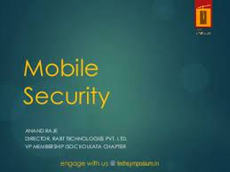
Lecture Objectives
In this lecture, we will discuss:
Mobile Security Fundamentals- Introduction to Mobile Security

Slide 3
Mobile Security
Mobile Device Security refers to the measures designed to protect sensitive information stored on and transmitted by laptops, smartphones, tablets, wearables, and other portable devices.
At the root of mobile device security is the goal of keeping unauthorized users from accessing the enterprise network.
Users carry mobile devices with them wherever they go, so administrators must worry about more physical attacks (e.g., theft and loss) and virtual threats from third-party applications and Wi-Fi hotspots (e.g., man-in-the-middle attacks).

Slide 4
Physical Threats
There are two main physical threats to a mobile device: data loss and theft. Natural disasters are also an issue, which would be the cause of data loss but not data theft. Lost data can be recovered, but data theft is an expensive issue for organizations.
Mobile devices have lock screens to help stop data theft after a device is stolen, but the technology must be strong enough to prevent an attacker from bypassing the screen lock by removing the storage device and extracting the information.
If device be stolen, it should request a few PIN attempts to get only to the home screen before locking the phone. This security feature stops brute-force home screen PIN attacks.
For devices with sensitive data, the company should use wipe applications that delete all data on the phone after several incorrect home screen PIN attempts.

Slide 5
Application Threats
Administrators can block applications from being installed on a desktop, but a user with a mobile device can install anything. Third-party applications introduce several issues to mobile device security.
Corporations must create a policy surrounding mobile devices to help users understand the dangers of installing unapproved third-party apps.
Third-party applications can also have hidden malware and keyloggers embedded in the code. Anti-malware programs can be installed, but rooted devices leave even these applications open to malware manipulation.

Slide 6
Network Threats
If the corporation offers public Wi-Fi hotspots for customers and employees, this too can be a point of concern.
When employees connect to public Wi-Fi and transfer data where other users can read data, it leaves the network vulnerable to man-in-the-middle (MitM) attacks and possible account takeover if the attacker steals credentials.

Slide 7
Web-Based and Endpoint Threats
Mobile apps connect to data and internal applications using endpoints. These endpoints receive and process data, and then return a response to the mobile device. The endpoints and any web-based application add threats to the organization.
Endpoints used by the application must be properly coded with authentication and authentication controls to stop attackers. Incorrectly secured endpoints could be the target of an attacker who can use them to compromise the application and steal data.
Because mobile devices have been increasingly more popular, some web-based attacks target these users. Attackers use sites that look like official websites tricking users into uploading sensitive data or downloading malicious applications.

Slide 8
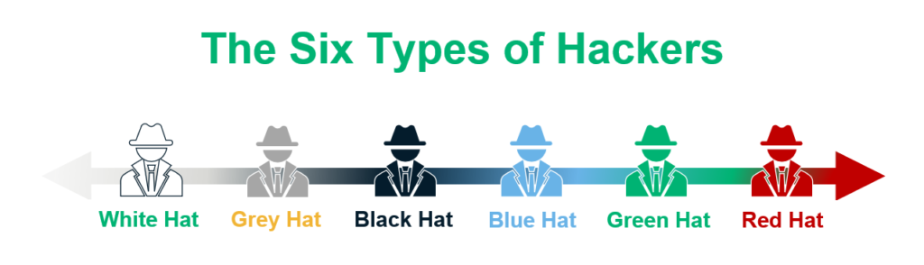
Types of attackers
https://sectigostore.com/blog/different-types-of-hackers-hats-explained/

Slide 9
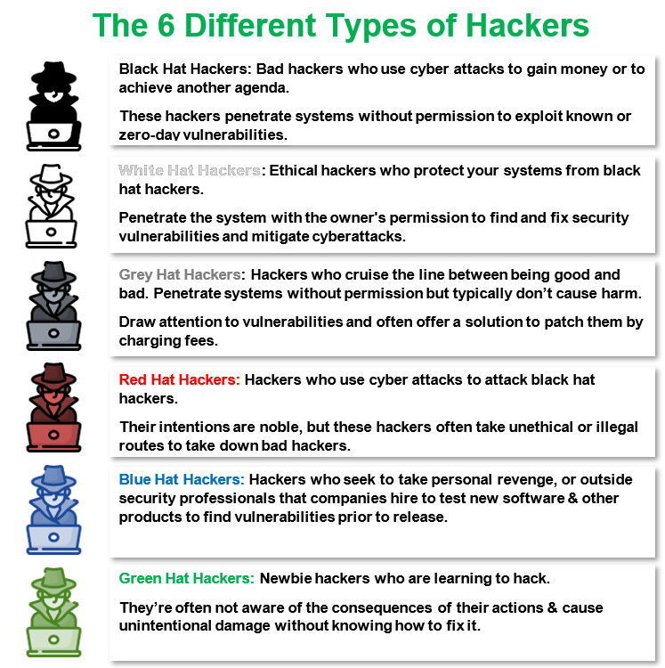

Slide 10
Components of Mobile Security
The following components will help any organization protect from attacks directed towards mobile devices:
Penetration scanners: Automated scanning services can be used to find vulnerabilities in endpoints. While this is not the only cybersecurity that should be used on endpoints, it’s the first step in finding authentication and authorization issues that could be used to compromise data.
VPN: Users connecting to the network from a remote location should always use VPN. VPN services and always on VPN alternatives installed on a mobile device will encrypt data from the device to the endpoint or from the device to the internal network. Plenty of third-party services are set up specifically for protecting corporate traffic from a mobile device to the internal network.

Slide 11
Auditing and device control: While administrators can’t remote control a smartphone or tablet, they can require users to install remote wiping capabilities and tracking services. GPS can be used to locate a stolen device, and remote wiping software will remove all critical data should it be stolen.
Email security: Phishing is one of the biggest threats to all organizations. Email services are usually added to a mobile device so that users can obtain their email messages. Any phishing messages could target mobile devices with malicious links or attachments. Email filters should block messages that contain suspicious links and attachments

Slide 12
Mobile security best practices
Establish, share, and enforce clear policies and processes
Password protection
Leverage biometrics
Avoid public Wi-Fi
Beware of apps
Mobile device encryption
For more detail : https://www.vmware.com/topics/glossary/content/mobile-device-security.html#:~:text=Mobile%20Device%20Security%20refers%20to,from%20accessing%20the%20enterprise%20network.

Slide 13
Malware Types
Notes:
http://media.kaspersky.com/pdf/Kaspersky-Lab-KSN-Report-mobile-cyberthreats-web.pdf

Slide 14
Cryptographic Misuse
Usage of ECB mode for encryption
Usage of static IV’s in CBC mode
Usage of hardcoded symmetric encryption keys
Usage of low iterations for password-based encryption
Bad seeding of random-number generators

Slide 15
References:
Books:
Hacking Exposed Mobile: Security Secrets & Solutions 1st Edition, Kindle Edition, by Neil Bergman, Mike Stanfield, Jason Rouse, and Joel Scambray
Hacking Exposed Web Applications, 3rd edition, Joel Scambray, Vincent Liu, Caleb Sima, Released October 2010, Publisher(s): McGraw-Hill
Video Lectures :
https://slideplayer.com/slide/6402052/
https://slideplayer.com/slide/6539985/
Reference Links:
https://www.slideshare.net/dilipdubey5/mobile-security-55068970.
https://slideplayer.com/slide/13906346/

Slide 16

THANK YOU

